Slide 1
PHP Programming with MySQL
Day 2

Slide 2
Defining Functions
Functions are groups of statements that you can execute as a single unit
Function definitions are the lines of code that make up a function
The syntax for defining a function is:
<?php
function name_of_function(parameters) {
statements;
}
?>
How is the PHP function syntax different from the Java method syntax?

Slide 3
Defining Functions
Functions, like all PHP code, must be contained within <?php ... ?> tags
A parameter is a variable that is passed to a function when it is called
Parameters are placed within the parentheses that follow the function name
Functions do not have to contain parameters
The set of curly braces (called function braces) contain the function statements

Slide 4
Defining Functions
Function statements do the actual work of the function and must be contained within the function braces
function displayCompanyName($Company1, $Company2, $Company3) {
echo "<p>$Company1</p>";
echo "<p>$Company2</p>";
echo "<p>$Company3</p>";
}

Slide 5
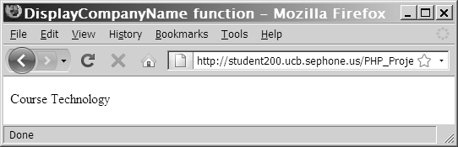
Calling Functions
function displayCompanyName($CompanyName) {
echo "<p>$CompanyName</p>";
}
displayCompanyName("Course Technology");
Figure 2-1 Output of a call to a custom function

Slide 6
Returning Values
A return statement returns a value to the statement that called the function
Not all functions return values
function averageNumbers($a, $b, $c) {
$SumOfNumbers = $a + $b + $c;
$Result = $SumOfNumbers / 3;
return $Result;
}

Slide 7
Returning Values
You can pass a function parameter by value or by reference
A function parameter that is passed by value is a local copy of the variable.
A function parameter that is passed by reference is a reference to the original variable.
Passing parameters by value (default):
function addNumbers($a, $b, $c) {
$a = $b + $c;
}
Passing parameters by reference:
function averageNumbers(&$a, &$b, &$c) {
$a = $b + $c;
}

Slide 8
Understanding Variable Scope
Variable scope is where in your program a declared variable can be used
A variable’s scope can be either global or local
A global variable is one that is declared outside a function and is available to all parts of your program
A local variable is declared inside a function and is only available within the function in which it is declared

Slide 9
The global Keyword
In PHP, you must declare a global variable with the global keyword inside a function definition to make the variable available within the scope of that function
<?php
$GlobalVariable = "Global variable";
function scopeExample() {
global $GlobalVariable;
echo "<p>$GlobalVariable</p>";
}
scopeExample();
?>

Slide 10
Making Decisions
Decision making or flow control is the process of determining the order in which statements execute in a program
The special types of PHP statements used for making decisions are called decision-making statements or decision-making structures

Slide 11
if Statements
Used to execute specific programming code if the evaluation of a conditional expression returns a value of TRUE
The syntax for a simple if statement is:
if (conditional expression)
statement;
The “if” statement contains three parts:
the keyword if
a conditional expression enclosed within parentheses
the executable statements
A command block is a group of statements contained within a set of braces
Each command block must have an opening brace ( { ) and a closing brace ( } )

Slide 12
if Statements
$ExampleVar = 5;
if ($ExampleVar == 5) { // condition evaluates to 'TRUE'
echo " <p>The condition evaluates to true.</p> ";
echo '<p>$ExampleVar is equal to ',
" $ExampleVar.</p> ";
echo " <p>Each of these lines will be printed.</p> ";
}
echo " <p>This statement always executes after the if
statement.</p> ";

Slide 13
if...else Statements
An if statement that includes an else clause is called an if...else statement
An else clause executes when the condition in an if...else statement evaluates to FALSE
The syntax for an if...else statement is:
if (conditional expression)
statement;
else
statement;

Slide 14
if...else Statements
An if statement can be constructed without the else clause
The else clause can only be used with an if statement
$Today = " Tuesday ";
if ($Today == " Monday ")
echo " <p>Today is Monday</p> ";
else
echo " <p>Today is not Monday</p> ";

Slide 15
Nested if and if...else Statements
When one decision-making statement is contained within another decision-making statement, they are referred to as nested decision-making structures
if ($SalesTotal >= 50)
if ($SalesTotal <= 100)
echo " <p>The sales total is between 50 and 100, inclusive.</p> ";

Slide 16
switch Statements
Control program flow by executing a specific set of statements depending on the value of an expression
Compare the value of an expression to a value contained within a special statement called a case label
A case label is a specific value that contains one or more statements that execute if the value of the case label matches the value of the switch statement’s expression

Slide 17
switch Statements
Consist of the following components:
The switch keyword
An expression
An opening brace
One or more case labels
The executable statements
The break keyword
A default label
A closing brace

Slide 18
switch Statements
The syntax for the switch statement is:
switch (expression) {
case label:
statement(s);
break;
case label:
statement(s);
break;
...
default:
statement(s);
break;
}

Slide 19
switch Statements
A case label consists of:
The keyword case
A literal value or variable name
A colon (:)
A case label can be followed by a single statement or multiple statements
Multiple statements for a case label do not need to be enclosed within a command block

Slide 20
switch Statements
The default label contains statements that execute when the value returned by the switch statement expression does not match a case label
A default label consists of the keyword default followed by a colon (:)

Slide 21
Exercise
Create a new password validation function in PHP:
Create a page with an HTML form where user can enter a new password twice. Both entries are expected to be the same.
Create a PHP script that applies the following validation:
If any of the password fields are empty, show an error message;
If the password fields’ values don’t match, show an error message;
If the validation was successful, show a “thank you” message.
You can reference user input using PHP $_POST, $_GET or $_REQUEST objects.

Slide 22
Repeating Code
A loop statement is a control structure that repeatedly executes a statement or a series of statements while a specific condition is TRUE or until a specific condition becomes TRUE
There are four types of loop statements:
while statements
do...while statements
for statements
foreach statements

Slide 23
while Statements
Tests the condition prior to executing the series of statements at each iteration of the loop
The syntax for the while statement is:
while (conditional expression) {
statement(s);
}
As long as the conditional expression evaluates to TRUE, the statement or command block that follows executes repeatedly

Slide 24
while Statements
Each repetition of a looping statement is called an iteration
A while statement keeps repeating until its conditional expression evaluates to FALSE
A counter is a variable that increments or decrements with each iteration of a loop statement

Slide 25
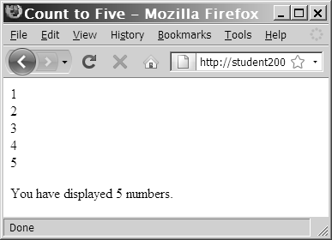
while Statements
$Count = 1;
while ($Count <= 5) {
echo " $Count<br /> ";
++$Count;
}
echo " <p>You have printed 5 numbers.</p> ";
Figure 2-5 Output of a while statement using an increment operator

Slide 26
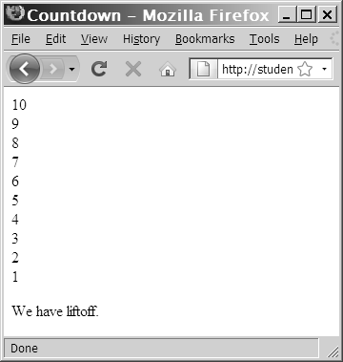
while Statements
$Count = 10;
while ($Count > 0) {
echo “$Count<br />”;
--$Count;
}
echo " <p>We have liftoff. </p> ";
Figure 2-6 Output of a while statement using a decrement operator

Slide 27
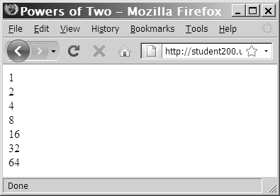
while Statements
$Count = 1;
while ($Count <= 100) {
echo " $Count<br /> ";
$Count *= 2;
}
Figure 2-7 Output of a while statement using the assignment operator *=

Slide 28
while Statements
In an infinite loop, a loop statement never ends because its conditional expression is never FALSE
$Count = 1;
while ($Count <= 10) {
echo " The number is $Count ";
}

Slide 29
do...while Statements
Test the condition after executing a series of statements then repeats the execution as long as a given conditional expression evaluates to TRUE
The syntax for the do...while statement is:
do {
statement(s);
} while (conditional expression);

Slide 30
do...while Statements
do...while statements always execute once, before a conditional expression is evaluated
$Count = 2;
do {
echo " <p>The count is equal to $Count</p> ";
++$Count;
} while ($Count < 2);

Slide 31
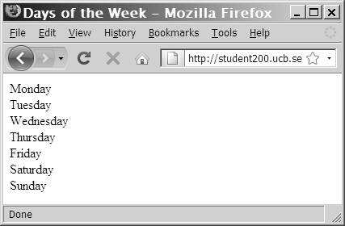
do...while Statements
$DaysOfWeek = array(" Monday ", " Tuesday ", " Wednesday ", " Thursday ",
" Friday ", " Saturday ", " Sunday ");
$Count = 0;
do {
echo $DaysOfWeek[$Count], "<br />";
++$Count;
} while ($Count < 7);
Figure 2-9 Output of days of week script in Web browser

Slide 32
for Statements
Combine the initialize, conditional evaluation, and update portions of a loop into a single statement
Repeat a statement or a series of statements as long as a given conditional expression evaluates to TRUE
If the conditional expression evaluates to TRUE, the for statement executes and continues to execute repeatedly until the conditional expression evaluates to FALSE

Slide 33
for Statements
Can also include code that initializes a counter and changes its value with each iteration
The syntax of the for statement is:
for (counter declaration and initialization; condition; update statement) {
statement(s);
}

Slide 34
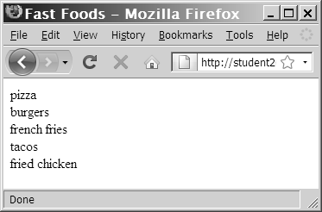
for Statements
$FastFoods = array(" pizza”, " burgers ", " french fries ", " tacos ", " fried chicken ");
for ($Count = 0; $Count < 5; ++$Count) {
echo $FastFoods[$Count], " <br /> ";
}
Figure 2-10 Output of fast foods script

Slide 35
foreach Statements
Used to iterate or loop through the elements in an array
Do not require a counter; instead, you specify an array expression within a set of parentheses following the foreach keyword
The syntax for the foreach statement is:
foreach ($array_name as $variable_name) {
statements;
}

Slide 36
foreach Statements
$DaysOfWeek = array("Monday", "Tuesday", "Wednesday", "Thursday", "Friday", "Saturday", "Sunday");
foreach ($DaysOfWeek as $Day) {
echo "<p>$Day</p>";
}

Slide 37
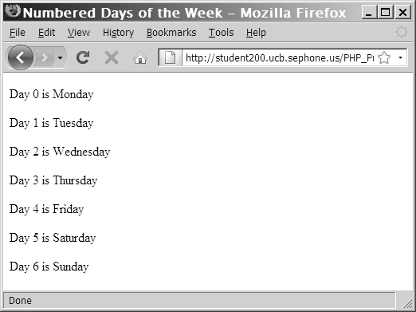
foreach Statements
$DaysofWeek = array("Monday", "Tuesday", "Wednesday", "Thursday", "Friday", "Saturday", "Sunday");
foreach ($DaysOfWeek as $DayNumber => $Day) {
echo "<p>Day $DayNumber is $Day</p>";
}
Figure 2-11 Output of the foreach script with index values

Slide 38
Including Files
The include and require statements reuse content by allowing you to insert the content of an external file on multiple Web pages
The include statement generates a warning if the include file cannot be found
The require statement halts the processing of the Web page and displays an error if the include file cannot be found
The include_once and require_once statements assure that the external file is added to the script only one time

Slide 39
Summary
The lines that make up a function are called the function definition
A function parameter that is passed by value is a local copy of the variable
A function parameter that is passed by reference is a reference to the original variable
A global variable is declared outside a function and is available to all parts of your program

Slide 40
Summary
A local variable is declared inside a function and is only available within the function in which it is declared
The process of determining the order in which statements execute in a program is called decision making or flow control
The if statement is used to execute specific programming code if the evaluation of a conditional expression returns a value of TRUE
An if statement that includes an else clause is called an if...else statement. An else clause executes when the condition in an if...else statement evaluates to FALSE
When one decision-making statement is contained within another decision-making statement, they are referred to as nested decision-making structures

Slide 41
Summary
The switch statement controls program flow by executing a specific set of statements, depending on the value of an expression
A loop statement is a control structure that repeatedly executes a statement or a series of statements while a specific condition is TRUE or until a specific condition becomes TRUE
A while statement tests the condition prior to executing the series of statements at each iteration of the loop

Slide 42
Summary
The do...while statement tests the condition after executing a series of statements
The for statement combines the initialize, conditional evaluation, and update portions of a loop into a single statement
The foreach statement is used to iterate or loop through the elements in an array
The include, require, include_once, and require_once statements insert the contents of an external file at the location of the statement

Slide 43
Exercise
Write a script that loops through Fahrenheit temperature values from -40 to +100 and displays Celsius equivalent (to get C subtract 32 from F and then multiply by 5/9);
Create a PHP page with header, content and footer. Header and Footer should be includes from other PHP files. The content section shall contain the Fahrenheit temperature conversion function.
Create an input page where the user enters a Fahrenheit value in a form field and submits the page. The Fahrenheit conversion function should highlight the corresponding Celsius temperature.
The header and footer of both pages should be sourced from the same include files.

